Slide 1
NEW HAVEN PUBLIC SCHOOLS
Promoting Inclusive Environments
New Haven Board of Alders
November 29, 2023
Dr. Madeline Negrón, Superintendent
Together, Striving Towards the Next Chapter of Excellence
Image: Unsplash.com
Artist: Ben Wicks

Slide 2
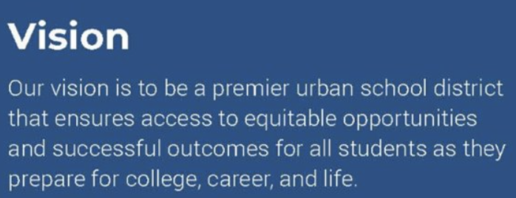
Strategic Plan SY 2020-2024

Slide 3
Promoting Inclusive Environments in NHPS
In New Haven Public Schools, we are committed to providing safe, supportive, welcoming and inclusive environments for all in our educational community.
We build inclusive environments through culture and climate, by
Increasing awareness
Providing safe spaces
Consulting with various stakeholder groups
Stakeholder feedback for our LGBTQ+ students has led us to understand that we must have essential supports in place for our LGBTQ+ students.
Image: Unsplash.com
Artist: Charlein Gracia

Slide 4
Promoting Inclusive Environments
Safe, Supportive Environments for All Students
Welcoming activities for families Professional development opportunities - Mental Health First Aid, Social-Emotional Learning (SEL), Restorative Practices, etc. Reducing & preventing bullying/Title IX - training for staff, Middle School student training Adopting affirming students' right to be free from harassment & discrimination Universal practices to include affirming and inclusive language | Welcoming and engaging activities within schools and classrooms School climate surveys Comer/MTSS model School counselors, social workers, school psychologists Transgender and Non-Conforming Gender Youth policy Honoring diverse traditions and holidays Social-Emotional Learning (SEL) universal lessons PreK-Grade 12

Slide 5
LGBTQ+ Affirming Environments
Capacity Building | Transgender and gender nonconforming youth policy-PD to unpack Administrator training via law firms Safe environments for LGBTQ+ youth training for staff - 20 schools Mental Health First Aid training series Bullying prevention/Title IX training for staff
Direct Services | Raising awareness through LGBTQ-affirming resources & systems: SEL Monthly, employee assistance program, promoting school PRIDE events, Google name changes, LGBTQ+ focus group, district Pride Month promotion Related Services staff for support Bullying prevention instruction for middle-school students
Inclusive Spaces | Pride events in schools Gender and Sexuality Alliances (GSAs) 82% of high schools all-gender bathrooms
Stakeholder Input | Climate survey Educator focus group Student focus group New Haven LGBTQ Youth Task Force

Slide 6
Promoting Inclusive Environments - Next Steps
Capacity Building | Yearly staff training re: transgender and gender nonconforming youth policy Ongoing Safe environments for LGBTQ+ youth training - additional schools Ongoing Research LGBTQ allyship training for staff October-December 2023 Mental Health First Aid training series January 2024 Provide access to resources: starting a GSA, website December 2023 Training program for identified “safe adults” January-March 2024
Direct Services | Raising awareness: LGBTQ-affirming resources Ongoing Identified “safe adults”-training December 2023 NHPS LGBTQ+ resources webpage December 2023
Inclusive Spaces | Increase Pride events in schools Ongoing Gender and Sexuality Alliances (GSAs) - scaling best practices Ongoing Identified “safe adults” with training - December March 2024 Promote consistent signage and symbols of inclusivity in schools January-June 2024
Stakeholder Input | Climate survey - monitoring progress Ongoing Continuation of educator focus group Ongoing Continuation of student focus group Ongoing Development of a parent/caregiver focus group January 2024 New Haven LGBTQ Youth Task Force collaboration Ongoing

Slide 7
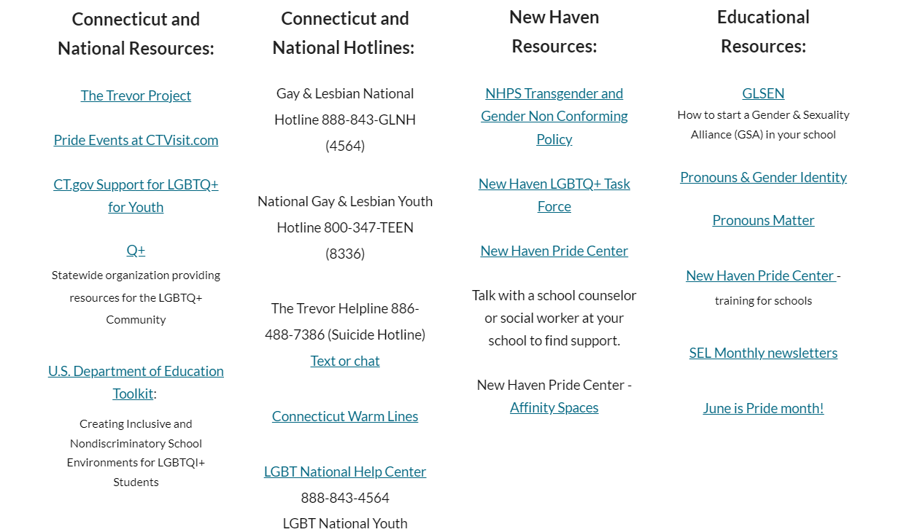
Promoting Inclusive Environments in NHPS
NHPS.net webpage
LGBTQ+ Resources
DRAFT
Notes:
Wepage draft -
https://sites.google.com/nhps.net/nhps-lgbtqresources/home?authuser=1

